Slide 1


Slide 2
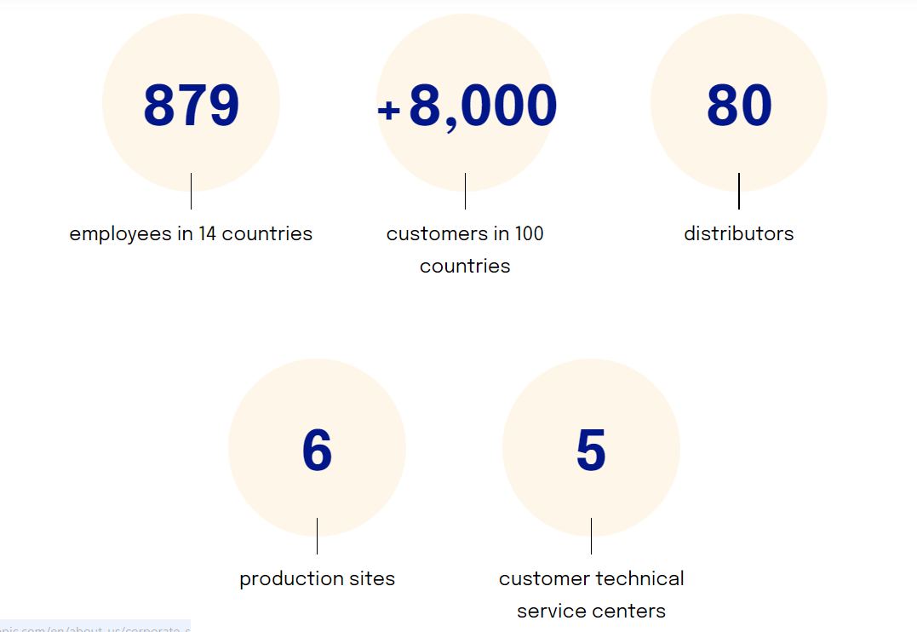
General overview
  Size of company: < 500
  Locations: Seppic operates globally, with production facilities, sales offices, and distributors around the world. They serve customers in over 100 countries, providing them with technical support and tailored solutions.
  Revenue: ?
  Private Company
  Funding/Investors: Because they are owned by
  AirLiquide, there is no funding or investors
  Website: https://www.seppic.com/en

Slide 3

End-markets they are in
Beauty Care
Dietary Supplements
Pharmaceuticals
Animal Health
Performance Materials

Slide 4
Specialty Ingredients
Emulsifiers
Texturizers
Polymers
Active ingredients
Excipients
Delivery systems

Slide 5
Summary of their Sustainability commitments
Seppic's supplier code of conduct
With our code of conduct, our suppliers commit to:
  Respecting human, labor, and other social rights.
  Doing business ethically.
  Preserving the environment.
  Protecting resources, notably data and information.

Slide 6
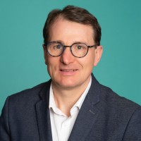
Work Experience
Education
Ecole Nationale Superieure de Chimie de Montpellier
Seppic (19y)
CEO and President (2y 11m)
SERDEX (Subsidary of SEPPIC) General Manager(1y)
Biotechmarine (Subsidary of Seppic) General Manager(4y 6m)
Guenole Le Calvez
CEO and President
I have a multidisciplinary profile within SEPPIC in Sales, Management of a Production unit and Management of Commercial operations and Commercial teams. I have also an international background .

Slide 7
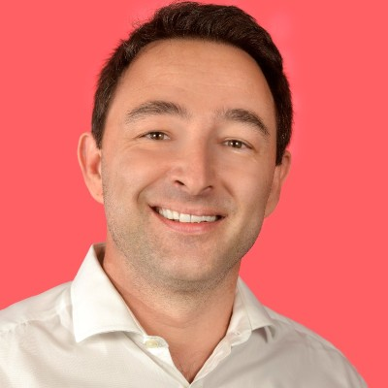
Work Experience
Education
CPE Lyon
Formation
SEPPIC (9 years)
Strategic Projects Manager (1 y 2m)
Product Development Project Manager (7 y 11m)
Liquid Air
R&D Project Coordinator (3Y 10 m)
University of Bordeaux
PhD Chimie
Claude Bernard Lyon 1
Masters; Chemistry
David Carteua
Strategic Projects
Manager
More than 10 years of experience in project management as well as cross-functional management in various fields: effluent treatment, hydrogen energy, antifouling paints, sensors, health (adjuvant and pharmaceuticals), cosmetics and nutrition.

Slide 8
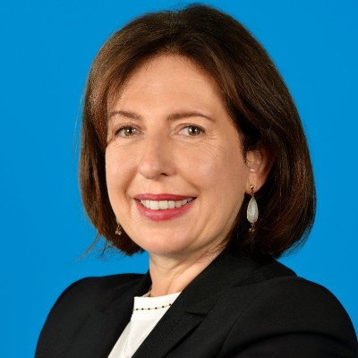
Work Experience
Education
IAE Paris – Sorbonne Business School
MBA Marketing, innovation
SEPPIC (10y 4m)
Strategy, M&A and Projects Director (1y 3m)
Innovation Department- Project Director (6y 8m)
Healthcare Business Unit – Sales Manager Human Health & Consumer Care (2y 6m)
Liquid Air (5 y 1m)
Industrial Merchant World Business Line- Product Manager (2y)
Pierre and Marie Curie University
PhD, Polymer Science
Cecile Apolinarski
Strategy, M&A
and Projects Director,
Specialty Ingredients
I am in charge of the team that manages strategy, acquisition projects and new product development in order to address SEPPIC's external and internal growth challenges.

Slide 9
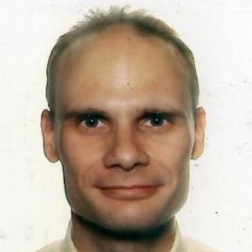
Work Experience
Education
Ecole Superieue de Chimi
Seppic (16y 4 m)
Open Innovation & Sustainable Innocation & Innovation Program Manager (5 y 1 m)
Development Program & Lean Innovation manager (3y 4m)
Development Projects Manager (4y 4m)
Regis Marchand
Open Innovation &
Sustainable Innovation &
Innovation Program
Manager

Slide 10
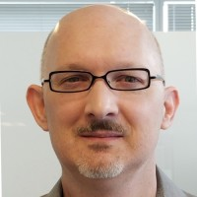
Work Experience
Education
University of Houston Law Center – Doctor of Law – JD Intellectual Property Law
Chief IP Counsel, North American Operations (11y 4m)
Air Liquide America 1(13y 11m)
Senior Patent Attorney (2y 7m)
The university of Texas Southwestern Medical School-Doctor of Philosophy – PhD Biochemistry and Molecular Biology
Allen White
Chief IP Counsel,
North American
Operations

Slide 11
Additional notes

